Slide 1
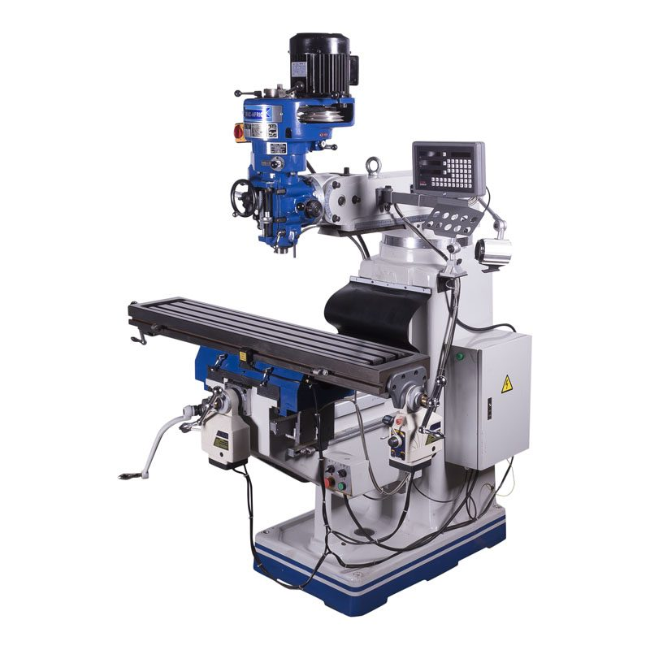
Minimizing Production Downtime Predictive Maintenance - Milling Machine
Ryan Wong, Anson Hsu,
James Baguley, Aidan Nguyen

Slide 2
Agenda
Problem Background
EDA
Objective, Decision Variables & Constraints
Programming
Report

Slide 3
Problem Background
Industry: Manufacturing, a milling machine is a tool that uses a spinning cutter to shape, cut, or drill into metal, wood, or other materials to make different parts and shapes, typically machine parts.
Business Problem: Downtime of Milling Machine affects target production
Project’s Objective:
Minimize Downtime
Ensure Production Capacity
Optimize Maintenance Resources
Data Points: 10,000 unique products
Notes:
Project’s Objective:
Minimize Downtime
Two types of downtime that we are measuring for each of the products: the parameters from our product, or if the machine might have a failure.
Ensure Production Capacity: Ensure that sufficient production capacity is maintained by coordinating maintenance tasks with production demand forecast.
Optimize Maintenance Resources: Allocate maintenance resources efficiently by prioritizing tasks based on machine health, criticality, and maintenance requirements.
2. We have 10,000 unique products in total and they were produced by a milling machine.

Slide 4
Analysis Dataset
Type: This column represents the product type, which can be L, M, or H (low, medium or high quality)
Temperature [C]: Overall process temperature, generated by calculating the difference between air temperature and process temperature
Rotational speed [rpm]: The rotational speed in revolutions per minute (rpm).
Torque [Nm]: The torque in Newton meters.
Tool wear [min]: The tool wear in minutes. The quality variants (H, M, L) add 5, 3, or 2 minutes of tool wear to the used tool in the process.
Notes:
Temperature, rotational speed, and torque are the parameters that might cause the machine to have more downtime.

Slide 5
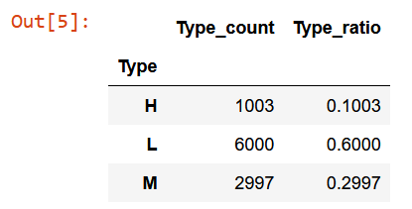
EDA
Count of Products by Quality:

Slide 6
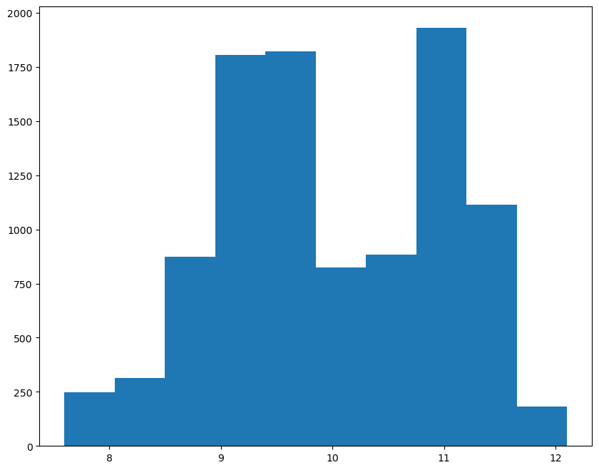
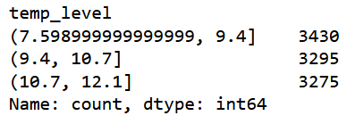
EDA
Range of Temperature:

Slide 7
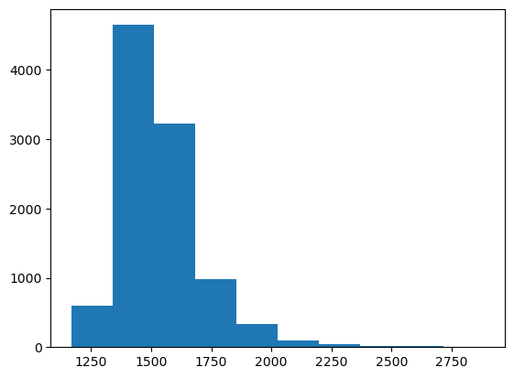
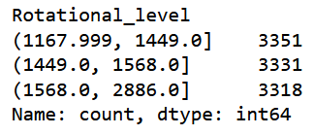
EDA
Range of Rotational Speed:

Slide 8
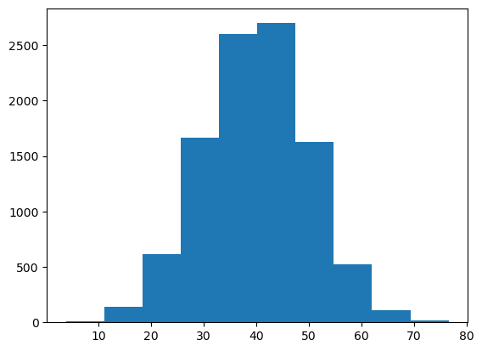
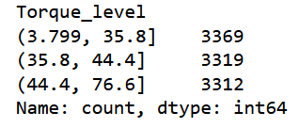
EDA
Range of Torque:

Slide 9
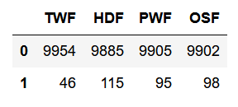
Variables of Failure
Machine failure consists of four independent failure states:
Tool Wear Failure (TWF): The tool will fail when the total tool wear time hits 200 minutes. In this data the tool fails 46 times.
Heat Dissipation Failure (HDF): Heat dissipation causes a process failure if the temperature drops below 8.6 K and the tools rotational speed is below 1380 rpm. This is the case for 115 data points.
Power Failure (PWF): The product of torque and rotational speed equals the power required for the process. If this power is below 3500 W or above 9000 W, the process fails, which is the case 95 times in our dataset.
Overstrain Failure (OSF): If the product of tool wear and torque exceeds 11,000 Nm/min for the L product variant, 12,000 for the M variant and 13,000 for the H variant, the process fails due to overstrain. This is true for 98 data points.

Slide 10
Downtime Formula
Temp (C):
(7.6C , 9.4C) : 0.1 min
(9.4C , 10.7C): 0.3 min
(10.7C , 12.1C): 0.5 min
Rotation (R):
(1167rpm , 1449rpm): 0.1 min
(1449.0rpm , 1568rpm): 0.3 min
(1568.0rpm , 2886rpm): 0.5 min
Torque (Q):
(3.799Nm, 35.8Nm): 0.1 min
(35.8Nm, 44.4Nm): 0.3 min
(44.4Nm, 76.6Nm): 0.5 min
Failure Downtime (F):
HDF: 10 min
PWF : 5 min
OSF: 3 min
TWF: 12 min
Tool Wear, or
Processing Time (W):
High Quality: 5 min
Medium Quality: 3 min
Low Quality: 2 min
Downtime Rate: Downtime / (Downtime + Processing Time)

Slide 11
Define Variables
Temperature ( C )
Rotation Speed ( R )
Torque ( Q )
G = { C, R, Q }, j∈G
P = { 1, 2, 3, …, 10000 }, i∈P
D_ij is a combination of C, R, Q
Notes:
Temperature: heat dissipation
rotational speed [rpm]: rotation of the number of rotations a machine or tool makes in one minute
Torque is a measure of the force that can cause an object to rotate about an axis
D is a matrix of 10,000 rows which represent the product for i from 1 to 10,000, column are C,R,Q downtime

Slide 12




Variables
Decision Variables
Xi: the number of product i
Other Variables
Wi: the tool wear min for product i

Slide 13
Objective Function
3 parts:
Downtime by an attribute of the product computed by C,R & Q
Downtime by failure
Downtime by tool wear
Notes:
Summation of all i in P and j in G with Dij and Xi. This is our obj func ti min dt, for total dt, first term is the total downtime by the temperature, rotation and torque . Dij is the matrix for these 3, Xi the number of product i -> Next 3 will be PWF< OSF< total downtime for these 3. F is fixed number of. fist term is the downtime is an attribute of the product computed by C,R&Q Last one calculate cumulative total minute ( TWF relate to total processing time), every 200 minutes, TWF will occur once. Total number of product

Slide 14



Constraints
L = { The set of product i in P that is Low Quality }
M = { The set of product i in P that is Medium Quality }
H = { The set of product i in P that is High Quality }

Slide 15



Constraints
Notes:
Ratio Yi is binary -> 1 mean i is assigned, from 1 to 10,000, we will know how many unique product assign. What is the ratio

Slide 16


Constraints
Min: the minimum quantity for product i (default = 1)
Max: The maximum quantity for product i (default = 100)

Slide 17
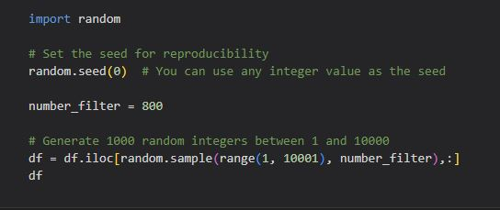
Programming
Gurobi only allow 2000 variables and 2000 constraint without license.
Filter 800 products in 10000

Slide 18
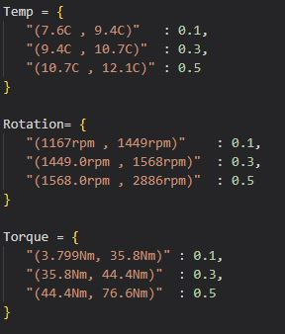
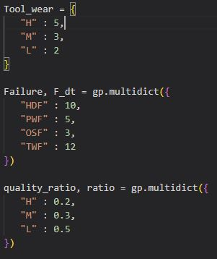
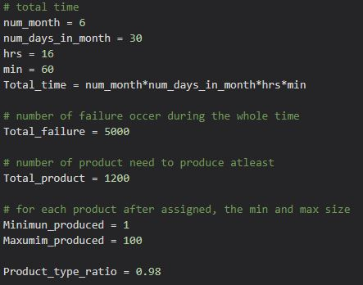
Programming
Parameters Tuning Panel

Slide 19
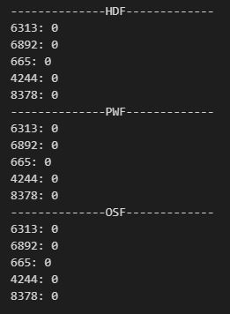
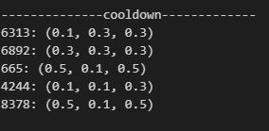
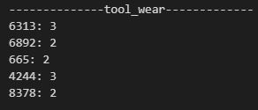
Programming
HDF : H_i
PWF : P_i
OSF : O_i
Cooldown : D_ij
Tool_wear : W_i

Slide 20
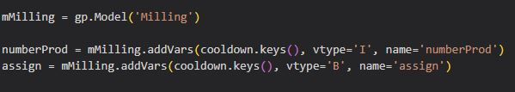
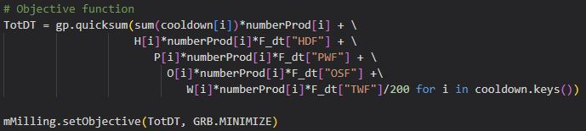
Programming
numberProd: Decision variable X_i (Integer)
assign: Decision variable Y_i (Binary)
Objective function: minimize total downtime

Slide 21
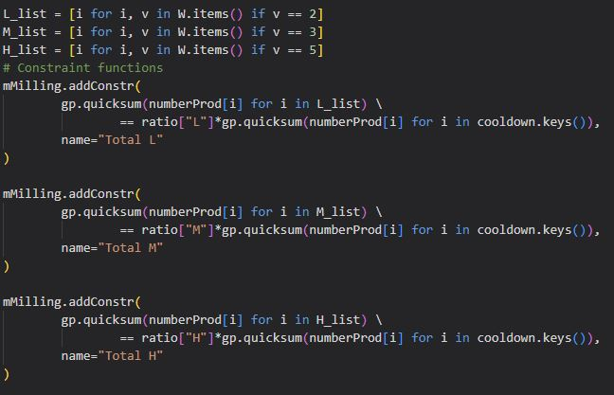
Programming
L_list, M_list, H_list: Subset of P
Three Constraints for ratio of different quality types

Slide 22
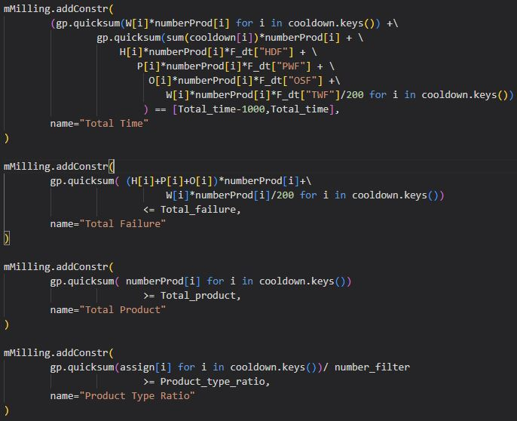
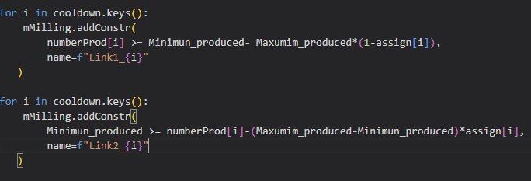
Programming
Rest of constraints

Slide 23
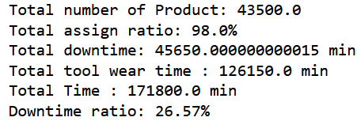
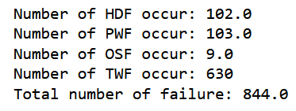
Results

Slide 24
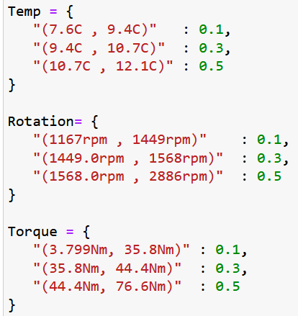
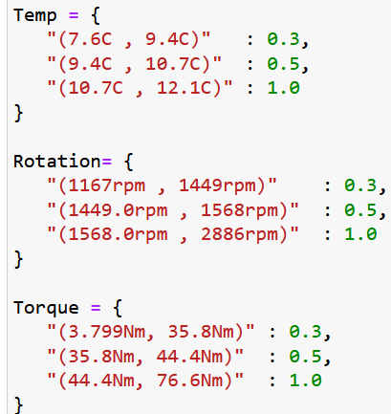
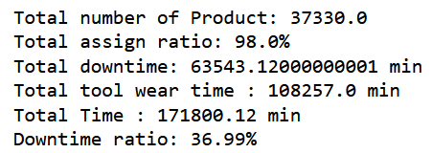
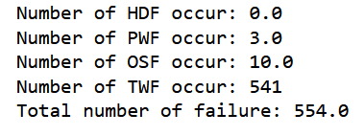
Scenario 2: Increase Parameter Downtime

Slide 25
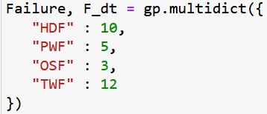
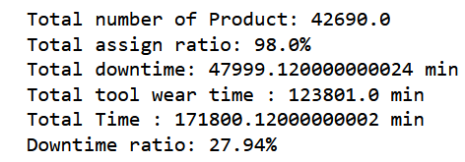
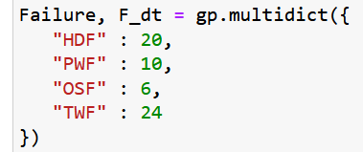
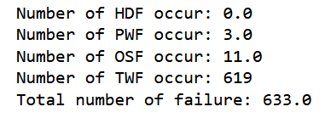
Scenario 3: Increase Failure Downtime

Slide 26
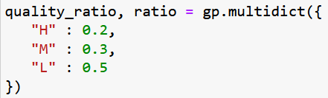
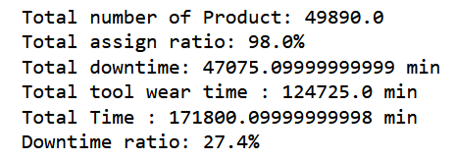
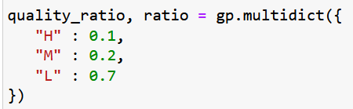
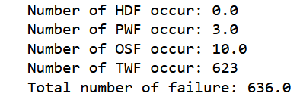
Scenario 4: Adjust Quality Ratio

Slide 27
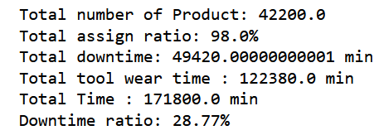
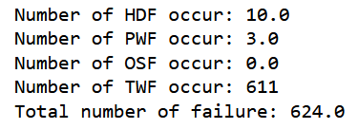
Scenario 5: Decrease Allowed Failure Rate

Slide 28
Conclusion
Limiting failure rates/increasing failure downtimes does not have a huge impact on percentage of downtime or the number of products produced, and so may be worth it to preserve machinery.
A higher proportion of lower quality products may also allow for higher production numbers and lower failure rates without contributing to downtime rate.

Slide 29
Thank You!

